Slide 1
Inpatient to Outpatient: Real-life applications across the spectrum of rehab
Carla Dippold, RN, BS, CRRN, CCM, CBIS
Director of Case Management
Tammy Miller, COTA/L, MHS, CCM, CBIST
Director of Outpatient Services

Slide 2
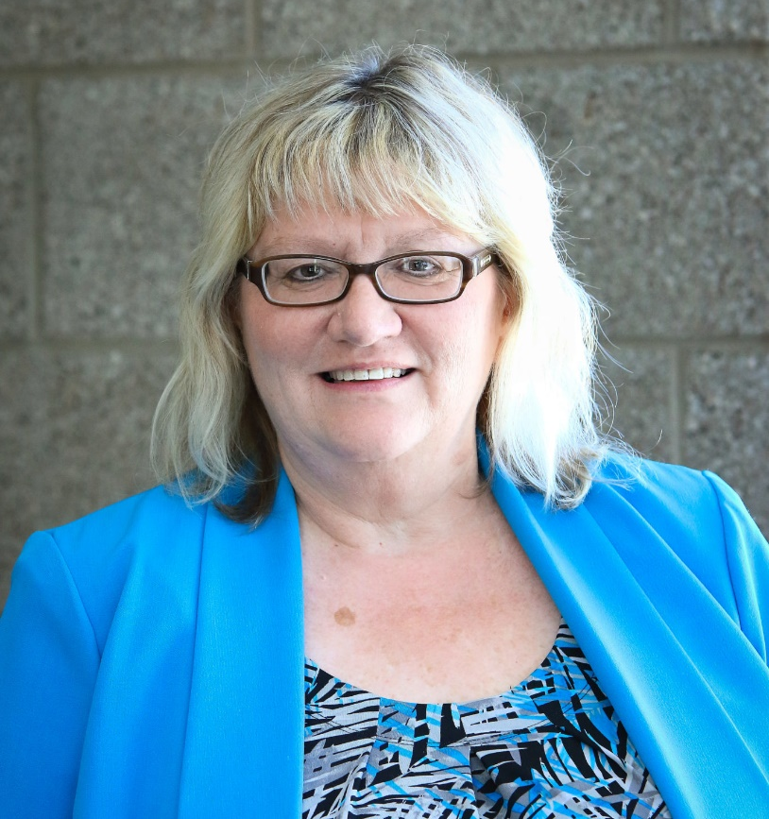
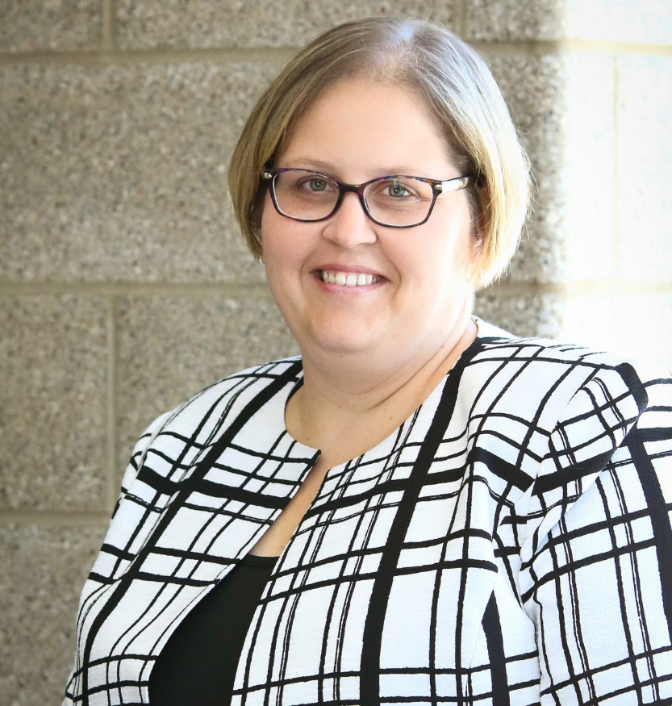
Carla Dippold, RN, BS, CRRN, CCM, CBIS
Director of Case Management
Tammy Miller, COTA/L, MHS, CBIS-T, CCM
Director of Outpatient Services

Slide 3
Disclosures
The presenters have no significant financial relationship with any commercial or proprietary entity that produces healthcare-related products and/or services relevant to the content of this presentation.

Slide 4
Objectives
At the conclusion of the webinar series participants will be able to:
  Generate an increased understanding of the various areas to address following a stroke
  Identify the importance of engagement in rehabilitation
  Demonstrate proficiency with basic stroke rehabilitation interventions

Slide 5
Transition Decision Tree
Initial Stroke & Emergency Room
Intensive Care Unit/Medical Stabilization
Medical / Neuro Unit
Decision #1 – Are there ongoing medical needs that require daily physician visits?
Rehabilitation
Notes:
If No: They are going to transition to LTACH or Acute IP rehab to manage the medical Needs
If YES: Then transition to a post acute rehabilitation program - - SNF, IP Acute, HH, OP

Slide 6
Acute Hospitalization
Focus on Diagnosis and Medical Stabilization
Therapy Evaluation and Intervention
Barriers to Anticipate/Prepare for
Notes:
ACUTE HOSPITALIZATION
Focus on Medical Management
Stabilization
Shorter hospital stay
Nutrition
Skin Integrity
Behavior Management
Sleep
Discharge Planning
Pain
Therapy Evaluation and Intervention:
Usual short, basic evaluation and intervention due to short stay
Assessing baseline/difference from baseline previous
Starting building blocks of rehab (sitting up, endurance, where they are at midline, vitals stabilization)
Building blocks for mobility: edge of bed sitting, transfers, beginning standing, midline, starting ambulation, sitting in chair)
Building blocks for ADL’s : dressing, grooming/hygiene, toileting – very basic initial stages
Additional areas starting to be addressed would include positioning (prevent contractures), range of motion, spasaticity management
Swallow evaluation – safety and need; communication needs
BARRIERS TO ANTICIPATE/PREPARE FOR:
Life and death decisions
Medical instability
Endurance
Crisis level of family/coping
Preparing family for next step in transition (i.e. rehab, home health, outpatient) that this is an ever changing process through different care levels – you won’t be in the same spot the whole time

Slide 7
INPATIENT REHABILITATION
Medical Management
Therapy Evaluation and Intervention
Barriers to Anticipate/Prepare for
Notes:
Medical Management
Inpatient Rehab
Continuing to monitor medical stabilization
Addressing medical needs such as:
Physician Oversight
Bowel and Bladder Function
Skin Integrity
Pain and Tone
Seizures
Sleep
Nutrition
Medication Overview – Hypertension, Clot Prevention, Diabetes
Nursing Skilled Care
Education (i.e. such as blood sugars, g-tube care, medications, daily cares, smoking cessation
Therapy Evaluation and Intervention:
Inpatient Rehab
Typically targeting 2+ core therapies
Focusing on and striving towards engagement (what is important to them, meaningful to them)
Continue to assess baseline/difference and progress
Expand upon the building blocks and progress forward (sitting up, endurance, where they are at midline, vitals stabilization)
Building blocks for mobility: edge of bed sitting, transfers, beginning standing, midline, starting ambulation, sitting in chair)
Building blocks for ADL’s : dressing, grooming/hygiene, toileting – very basic initial stages
Continue to address and become more aggressive with positioning (prevent contractures), range of motion, spasaticity management
Speech/language intervention and communication strategies
Swallow evaluation, trials, and self feeding
Education of PS/Families
Feeding
Transfers/mobility with family/caregiver and self
Promoting independence
About their stroke
Rehab 16 Concept at On With Life is really how we address this…..
Look at rehab as all day everyday is rehab based on 16 hours you are awake and 8 hours of sleep everyday
Every intervention, interaction, transfer, daily care….is an opportunity for rehab
“Formal” therapy is still happening at 3+hours/day 5+days/wk
BARRIERS TO ANTICIPATE/PREPARE FOR:
Medical instability/stability
Endurance – have to be able to tolerate the 3+ hours/day at some levels
Crisis level of family/coping – different level – looking in future; struggling with the new ‘norm’
Accessibility with the home
Need for Care – 24/7 difficult; limited support
Financial
Preparing family for next step in transition (i.e. rehab, home health, outpatient) that this is an ever changing process through different care levels – you won’t be in the same spot the whole time

Slide 8
OUTPATIENT REHABILITATION
Collaborative Medical Management/Oversight
Therapy Evaluation and Intervention
Barriers to Anticipate/Prepare for
Notes:
Medical Management
Outpatient Rehab
Making sure they are going to their PCP’s/Physicians involved in care; reporting any issues
Hope is that medical management takes a back seat during this time – they continue to be managed
Monitoring ongoing medical needs– but more from a collaborative approach (i.e. notifying physician/education PS, making sure they are follow up appointments)
Pain/Tone/Skin – feedback and oversight to physicians based on what we are seeing in therapy and PS report
Making sure they are able to take their medications (putting them in planners coreectly)
Able to do blood sugars and give injections
Self cathing – teaching techniques/modifications physically to be able to do this.
Checking blood pressures
Monitoring skin integrity
If issues identified collaborating with the medical provider (PCP, neurologist, etc)
Focus continues to be on Prevention – hypertension, diabetes, weight management, cholesterol, prophylaxis for DVT, smoking cessation
Therapy Evaluation and Intervention:
At this level focus is highly on therapy and home living
Therapies can be just 1 or multiple; no requirement – based on need
Focusing on and striving towards engagement (what is important to them, meaningful to them) – potentially things like return to work, school, driving, etc.
What’s important to them and brings quality of life
Continue to assess baseline/difference and progress
Continued focus on progressing mobility, adl’s, FUNCTION, safety, problem solving home situations, fine tuning once reality sets in
Trialing of alternative methods and problem solving
If this set up at home didn’t work, could we figure out and trial and different set up?
Are they having difficulty getting to appointments? If so, is there a strategy or method we can find that works best for them
Education of PS/Families
Home programs
Training with families with what they are struggling with
New hurdles and goals
BARRIERS TO ANTICIPATE/PREPARE FOR:
Medical instability/stability (new medical incident, falls, etc)
Safety concerns – are they arising? Falls, confusion, wandering, etc
Do they have right resources in place? (do they have the ability to get help)
Crisis level of family/coping – different level – reality is setting in – financial concerns are usually huge at this stage)
Accessibility with the home
Need for Care – 24/7 difficult; limited support

Slide 9
CASE MANAGEMENT
Plan
Identify Needs and Resources
Advocate
Prepare for the worst….hope for the best
Notes:
CASE MANAGEMENT: (IP and OP)
PLAN
Realistic discussion (i.e. the person that wants to go home, but has not supports and dependent with care – how do you help them get there in that discussion)
Supervision and assistance (amount needed, what family can provide, is there limited time they can provide it)
Are there other family/community supports (i.e. church families, private pay caregivers, agency care)
Have a plan B – if they are home and things are not going well, burnout, overwhelmed (what is available, prepare for emergencies)
What’s the next step - Facilitating the discharge process (aligning most appropriate care level and what they qualify for and the most support services that can be arranged for safety net)
IP – going to significantly less caregiver options in most cases (it now on the family)
OP – transitioning to ‘getting on with life’ – return to work, school, home programs, LESS FORMAL THERAPY – this is difficult for people
IDENTIFY NEEDS AND RESOURCES:
What community are they in, what do they need, what is available, what do they qualify for
Are there community groups? – social and physical/financial assistance in some cases
Day Care
Respite Care
Outpatient Therapy that meets the need of the individual
Support Groups
What are their resources? (people, financial, housing, community resources – transportation, Medicaid, waiver, etc)
ADVOCATE/COMMUNICATE:
Encourage them to ask questions and speak up
If something doesn’t feel right – ask about it
Ask for services that are available/qualify for
Ask friends and neighbors –
Often people want to help, but don’t know how.
We don’t want to always ask for help or inconvenience people, but giving the opportunity to them is often all they need to be able to step in
Advocate for them….don’t be afraid to challenge the insurance
Push back on the insurance (formal - appeals) (informally – ask if they have hard cap/soft cap)
Ask if the insurance has a case manager that can help in the community
Organizationally you can also educate and advocate with your insurance payors as well about your services and the needs of the persons you serve.
PREPARE FOR THE WORST….HOPE FOR THE BEST
Having the person in the right place and the right time and getting the right services is the goal

Slide 10
Contact Information
Carla Dippold, Director of Case Management
515-289-9600 x 110
Carla.dippold@onwithlife.org
Tammy Miller, Director of Outpatient Services
515-289-9600 x162
Tammy.Miller@onwithlife.org

Slide 11
Thank You!

